Slide 1


Referral System Learning Workshop
Wednesday, April 15 – Thursday, April 16, 2015
Zach Andersson, Livelihood and Food Security Analyst (Washington, DC)
Amakhosi Jere, Project Coordinator (Malawi)

Slide 2
Workshop Agenda
Opening
  Explanation of LIFT II closeout in Karonga and workshop objectives
Picking up where we left off
  Past LIFT engagement
Review of referral systems
  Justification and benefits
  Basic elements
  Past referrals in Karonga?
LIFT project learning
  Types of systems used
  Tools developed
Referral network in Karonga
  How can work continue?
  Who can champion?
  How can KRN become strong and be sustained?
Action planning
  Questions to guide you…
Closing
  Agreeing on the way forward, AOB, closing prayer

Slide 3
  Let’s all participate and make this a productive time together!
    No question is too silly
    Many of you have very valuable experiences already, which your colleagues should be aware of
    I will share some of what LIFT has done at our project sites, but this is meant to be useful for you all to carry referral work forward, so we need to hear your voices!

Slide 4
Reminder about LIFT II: USAID’s Livelihoods and Food Security Technical Assistance Project

Slide 5
LIFT’s Purpose and Goals
Purpose
  Connect vulnerable people (especially PLHIV) to economic strengthening, livelihoods, and food security services in their community
  Connect services, especially HIV/nutrition programs based at health facilities to other services.
Goal
  Improve health outcomes for clients (especially adherence and retention in HIV care and treatment)
  Improve household food security and economic outcomes
Perhaps your Objectives are Similar?
  We will revisit targeting later

Slide 6
LIFT & Service Providers
LIFT works with local service providers in DRC, Lesotho, Malawi, Namibia, Tanzania and Zambia
LIFT works with the following services:
  Nutrition and HIV (our mandate from PEPFAR/USAID)
  Economic Strengthening
  Livelihoods
  Food Security
We often say “ES/L/FS”
In Malawi we work with the MOH’s NCST Program (Nutrition Care, Support and Treatment), specifically in Balaka, Lilongwe and Kasungu Districts
  We use two different “approaches” in these three districts
  We will explain them more later

Slide 7
LIFT Closeout in Karonga – Why?
Staff turnover at the end of 2014, in addition to changing USAID priorities and the impending end of LIFT II funding in September, 2015, led us to decide to prioritize work already underway in the three other Malawi sites
LIFT is facilitating this workshop in order to transfer lessons learned to a core group of Karonga service providers, help plan continued development of a RN here, and explain some of the tools that can be used to formalize a referral system

Slide 8
Recap: LIFT’s Organizational Network Analysis (ONA) and Service Directory

Slide 9
Remember the ONA?
Organizational Network Analysis
Series of interviews with service providers (organizations) in Karonga
  LIFT interviewed 20 service providers in Karonga from August 11-15, 2014
Object of the interviews is to ask about relationships between service providers
LIFT’s goal is to connect clients from health facilities to other services

Slide 10
The Six Relationships
Any relationship
Joint Programs
Send Clients
Receive Clients
Send Information
Receive Information

Slide 11
Codes used in Sociograms
ARC | Association for Rural Community Development (ARCOD) | KYI | Kachila Youth Initiative
BFS | Blue Financial Services | LCO | Lusobilo Community-based Orphan Care Project
BLM | Banja La Mtsogolo (BLM) | LIS | LISAP
CIS | CISP - Rice Value Chain Development Project | MAC | Malawi AIDS Counseling and Resource Organization (MACRO)
CRH | Chilumba Rural Hospital | NAP | NAPHAM
FIN | FINCA | NAS | NASFAM
FOC | Foundation for Community Support Services (FOCUS) | NHC | Nyungwe Health Center
FPC | Future Planning for the Child | SHA | Self Help Africa - DISCOVER Project
KDH | Karonga District Hospital | TCO | Tikwere Community Organization (SACCO)
KRH | Kaporo Rural Hospital | WVI | World Vision

Slide 12
3. Send Clients
In an average month, do you send clients to
[service provider]?

Slide 13
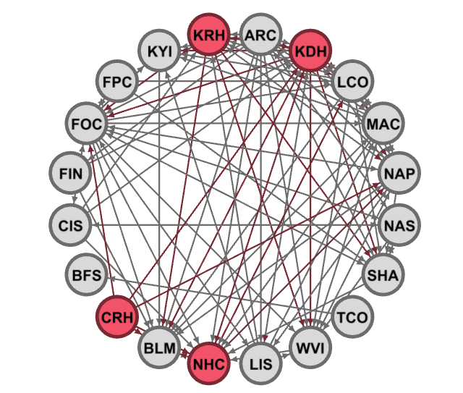

Slide 14
4. Receive Clients
In an average month, do you receive clients from
[service provider]?

Slide 15
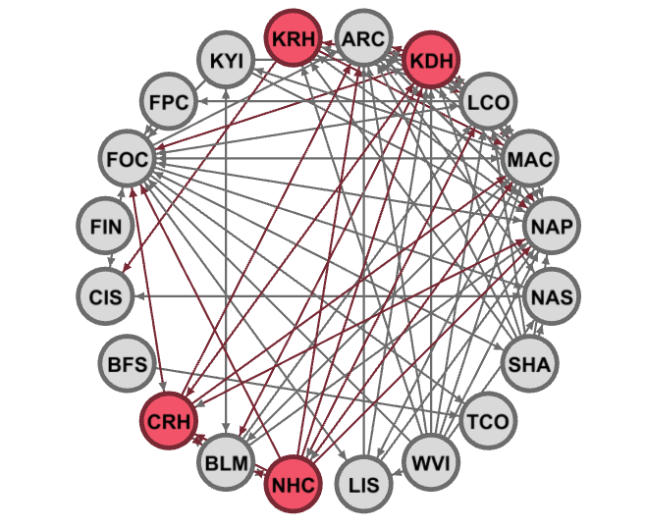

Slide 16
Lessons from Karonga ONA
Service providers already collaborating a lot!!
  Most SPs are sending and receiving clients, and the level of joint programming (in whatever form) is high
There is a good justification for a referral system in that it expands the services each SP offers (because you can refer clients to a partner)
  Each individual may have many unique needs, and you can’t address all of them yourself!
  By referring, you are helping your clients comprehensively
How can we use existing connections in Karonga to benefit all service providers?

Slide 17
Benefits of Referral Systems
Why collaborate and share information?

Slide 18
First, Definitions
Referral Network (RN)
Referral System (RS)
The service providers that agree to refer clients to each other
A set of tools for managing referrals
A way to collect data that is useful to all referral network members

Slide 19
Participating in a network allows you to:
Help more clients
Improve publicity
Work on a Systems Level
Define your image

Slide 20
Help More Clients
Health study from Malawi showed that people newly diagnosed with HIV are likely to have others within their social networks that are undiagnosed
  This highlights the potential in utilizing existing networks to reach more vulnerable people
  This is health research, but the lesson extends to other services that want to identify clients more efficiently
Notes:
People newly diagnosed with HIV/STIs often have individuals with undiagnosed HIV in their social network
Michael Carter
Published: 30 December 2013
Asking people who are newly diagnosed with HIV or a sexually transmitted infection (STI) to recruit contacts in their social network for HIV/STI screening is an effective way of detecting previously undiagnosed infections, investigators report in the online edition of the Journal of Acquired Immune Deficiency Syndromes. The study was conducted in Malawi. Patients were asked to recruit up to five individuals from their social or sexual network for testing.
“Asking STI patients to recruit their social contacts was a feasible, effective and efficient way of diagnosing new HIV cases in a generalized epidemic,” write the authors. “To identify one new case of HIV infection only 8-10 contacts of clinic seeds needed to be tested for HIV, much better efficacy than random testing in the population.”
Approximately 11% of adults in Malawi are HIV positive. But up to a third of HIV cases are undiagnosed. Reducing the proportion of undiagnosed infections is a public health priority. An international team of investigators wanted to see if social network recruitment by people newly diagnosed with HIV/STIs was an efficient and effective way of reaching people with previously undiagnosed infections.
They therefore designed a study involving two groups of patients – each numbering 45 individuals – who accessed care at the STI clinic at Kamuzu Central Hospital in Lilongwe, Malawi between 2010 and 2012. The first group comprised people newly diagnosed with HIV; the second comprised people diagnosed with an STI but not HIV. A control arm consisted of 45 individuals without HIV or an STI were also recruited from the general, local population.
All the participants were aged between 18 and 45 years. They were asked to recruit up to five individuals in their social or sexual network for HIV/STI screening.
Almost two-thirds of participants were women and the mean age was 27 years.
The participants recruited a total of 244 contacts. Over two-thirds (69%) of individuals recruited from the community recruited at least one contact, compared to 53% of STI patients and 47% of HIV-positive participants.
Almost two-thirds (62%) of contacts were friends or neighbours of the recruiting individual, 18% were family members, 11% were sexual contacts (primarily spouses) and 8% had another relationship.
Most of the contacts (64%) were female and their mean age was 28 years.
HIV prevalence was three times higher among the contacts of the HIV-positive patients than the contacts of the community controls (31 vs 11%).
The contacts of the HIV-positive patients and patients with STIs were more likely to have an STI than the contacts of the community controls (29 vs 19 vs 9%).
A total of 20 patients were newly diagnosed with HIV through the study. Seven of these individuals were recruited by patients with HIV, seven by STI patients and six by community controls.
In order to identify one new case of HIV it was necessary to screen eight contacts of the HIV patients; ten contacts of the STI patients and 18 contacts of the community controls.
To identify one new STI, six contacts of patients with HIV, four contacts of STI patients and eleven contacts of community controls required screening.
Identification of one new case of HIV or a new STI required the screening of four contacts of patients with HIV, three contacts of STI patients and seven contacts of the controls.
“High risk persons tend to associate with other persons who engage in similar high risk activities,” write the authors. “Even in the context of a generalized HIV epidemic, STI and HIV risk was not evenly distributed, but rather, clustered in social networks.”
The investigators believe their findings have implications for HIV screening and testing strategies. “Our findings reflect a novel strategy for addressing a pressing public health need: identifying undiagnosed, hard-to-reach cases of HIV infection,” they conclude. “We demonstrated that asking STI patients to recruit their social contacts was a feasible, effective, and efficient way of identifying this population. These observations support social contact recruitment extending the reach of the healthcare screening system. Such an approach could become a powerful way of identifying HIV in hard-to-reach populations earlier.”

Slide 21
Use Data for Program Decisions
A study conducted in rural Uganda showed that food secure PLHIV have higher retention in care
Food insecure PLHIV have 50% higher odds of defaulting on treatment and 47% higher odds of a CD4 count below 350
  These results are significant and illustrate the relationship between food security and HIV
  Improve food security → improve retention in HIV care
Notes:
Longitudinal assessment of associations between food
insecurity, antiretroviral adherence and HIV
treatment outcomes in rural Uganda
Sheri D. Weisera, Kartika Palarb, Edward A. Frongilloc,
Alexander C. Tsaid, Elias Kumbakumbae, Saskia dePeef, Peter W. Hunta,
Kathleen Raglanda, Jeffrey Marting and David R. Bangsbergd,e,h,i,j
Introduction: Food insecurity is a potentially important barrier to the success of
antiretroviral therapy (ART) programs in resource-limited settings. We undertook a
longitudinal study in rural Uganda to estimate the associations between food insecurity
and HIV treatment outcomes.
Design: Longitudinal cohort study.
Methods: Participants were from the Uganda AIDS Rural Treatment Outcomes study
and were followed quarterly for blood draws and structured interviews. We measured
food insecurity with the validated Household Food Insecurity Access Scale. Our
primary outcomes were: ART nonadherence (adherence <90%) measured by visual
analog scale; incomplete viral load suppression (>400 copies/ml); and low CD4þ T-cell
count (<350 cells/ml). We used generalized estimating equations to estimate the
associations, adjusting for socio-demographic and clinical variables.
Results: We followed 438 participants for a median of 33 months; 78.5% were food
insecure at baseline. In adjusted analyses, food insecurity was associated with higher
odds of ART nonadherence [adjusted odds ratio (AOR) 1.56, 95% confidence interval
(CI) 1.10–2.20, P<0.05], incomplete viral suppression (AOR 1.52, 95% CI 1.18–1.96,
P<0.01), and CD4þ T-cell count less than 350 (AOR 1.47, 95% CI 1.24–1.74,
P<0.01). Adding adherence as a covariate to the latter two models removed the
association between food insecurity and viral suppression, but not between food
insecurity and CD4þ T-cell count.
Conclusions: Food insecurity is longitudinally associated with poor HIV outcomes in
rural Uganda. Intervention research is needed to determine the extent to which
improved food security is causally related to improved HIV outcomes and to identify
the most effective policies and programs to improve food security and health.
2013 Wolters Kluwer Health | Lippincott Williams & Wilkins
AIDS 2014, 28:115–120

Slide 22
Understand Client Choices
Research from Ntcheu, Malawi on “Decision Mapping”
  Service providers within a referral network can work together to understand choices clients face as they are deciding between services to access
    This can be useful for service providers to help them understand what clients want
    This will help organizations define a targeting strategy and improve eligibility criteria (more to come soon…)
Notes:
Title: Using decision mapping to inform the development of a stated choice survey to elicit youth
preferences for sexual and reproductive health and HIV services in rural Malawi
Abstract:
The process of designing and developing discrete choice experiments (DCEs) is often under
reported. The need to adequately report the results of qualitative work used to identify attributes
and levels used in a DCE is recognised. However, one area that has received relatively little attention
is the exploration of the choice question of interest. This paper provides a case study of the process
used to design a stated preference survey to assess youth preferences for integrated sexual and
reproductive health (SRH) and HIV outreach services in Malawi.
Development and design consisted of six distinct but overlapping and iterative stages. Stage
one was a review of the literature. Stage two involved developing a decision map to conceptualise
the choice processes involved. Stage three included twelve focus group discussions with young
people aged 15-24 (n= 113) and three key informant interviews (n=3) conducted in Ntcheu District,
Malawi. Stage four involved analysis of qualitative data and identification of potential attributes and
levels. The choice format and experimental design were selected in stages five and six.
The results of the literature review were used to develop a decision map outlining the choices
that young people accessing SRH services may face. For youth that would like to use services two key
choices were identified: the choice between providers and the choice of service delivery attributes
within a provider type. Youth preferences for provider type are best explored using a DCE with a
labelled design, while preferences for service delivery attributes associated with a particular
provider are better understood using an unlabelled design. Consequently, two DCEs were adopted
to jointly assess preferences in this context.

Slide 23
Understanding Client Choices (2)
Study on informed choice in Tanzania
  This study looked at perceptions of clients when provided with
    A) multiple service choices versus
    B) direct advice
    Too many choices (option A) can sometimes create uncertainty, whereas direct advice (option B) can lead to increased confidence in service provider
  Importance of trust between client and service provider
Notes:
1 Abstract
2 A growing emphasis on patient involvement in health care has brought ‘informed choice’ to
3 the core of the debate on provider-patient interaction in global health-care programmes. How
4 the principles of patient involvement and informed choice are implemented and experienced
5 in diverging health systems and cultural contexts are issues of increasing interest. Infant
6 feeding and infant feeding counselling of HIV-positive women have posed particular
7 challenges related to choice. Based on ethnographic research conducted from 5 November
8 2008 to 5 August 2009 within prevention of mother-to-child transmission of HIV (PMTCT)
9 programmes in two hospitals in rural and semi-urban Tanzania, this study explores nurse
10 counsellors’ and HIV-positive women’s experiences of infant feeding counselling and patient
11 choice. One of the hospitals (hospital A) promoted exclusive breastfeeding as the only infant
12 feeding option, while the other hospital (hospital B) aimed to follow the Tanzanian PMTCT
13 infant feeding guidelines of 2007 promoting patient choice in infant feeding methods. Women
14 in hospital A expressed trust in the advice given and confidence in their own ability to
15 practice exclusive breastfeeding, while women in hospital B expressed great uncertainty and
16 confusion about how best to feed their infants. This paper reflects on the feasibility of a
17 counselling procedure that promotes choice of infant feeding methods in PMTCT
18 programmes in severely resource-poor settings where HIV-positive women have limited
19 access to resources and to up-to-date knowledge on HIV and infant feeding outside the
20 counselling room. We suggest that a universalistic procedure presenting the same
21 unambiguous message on infant feeding to all women enrolled in the PMTCT programme in
22 this and similar settings is likely to produce more confidence, less confusion and, hence,
23 better results in terms of HIV-free survival of the baby.

Slide 24
Work on a Systems Level
Lack of coordination among providers can cause fragmented service delivery
  Client may drop out of treatment as a result
  Referral system and diagnostic can “standardize” a process/routine
  Network and referral system can help client receive all needed services
Working together helps promote a comprehensive understanding of client’s needs
Notes:
When the many agencies that work with vulnerable clients work independently of each other, the result is that the client is subject to fragmented services, none of which might address the client as a whole person.
One of the biggest challenges to any collaborative or network-based model occurs when each of numerous agencies wants to use a different assessment tool to gather the same information. At best, this produces a fragmented portrait of the client; at worst, it creates frustration and confusion for the client, who may drop out of treatment as a result.
Referral system and diagnostic can “standardize” a process/routine
A shared vision among potential collaborators facilitates strategies to achieve common goals (Nelson et al., 1999). The biggest benefit of collaboration among health agencies is the improved health of clients and therefore of the community. One study found that health is dependent on how people perceive the quality of their community. Leadership and vision among collaborative agencies can make a difference in the quality of a community health care system and in the cost-effectiveness of the care provided (Molinari et al., 1998).
Collaboration among agencies is the key to preventing fragmentation. In addition to reducing the likelihood of clients falling through the cracks between disparate and unconnected agencies, collaboration can foster a more holistic view of the client. Sometimes just a simple change of perspective can make the difference between circumstances being viewed as "needs" and being viewed as assets.
With effective collaboration, service providers will learn to recognize these differing viewpoints through their contact with professionals with expertise in different areas.

Slide 25
Define Your Image
Notes:
SUMMARY OF OTHER REASONS: Transportation Problems 9 Programmatic Problems 6 Corruption/Nepotism 8 Other 11 (unintelligible) TOTAL 34
Some of these are within your control, others can’t be addressed

Slide 26
Past Referral Systems in Karonga
Some of you have experience with referral systems in the past
  Can you share a bit about this?
  Formal or Informal?
  At what level was the system implemented?
    District or TA or Community
  How did it go?
  What were the main challenges?
  What were the main successes?
  Why did it stop?
  Do you think that by working together to plan such a system as a group, your experience will be helpful?

Slide 27
Counseling, eligibility criteria, and targeting

Slide 28
Definitions
When we are talking about referrals:
  Counseling is the process of discussing different services with a client
  Eligibility Criteria are specific things a client must have to use a service (for example: be a woman, live in a certain village, pay a certain fee, etc.)
  Targeting is your organization’s strategy for identifying and serving new clients
Targeting is general; Eligibility Criteria are specific.

Slide 29
Counseling is Crucial
Eligibility Criteria in a Service Directory
  Must be strong and as complete as possible for clients to receive useful referrals
    Clients have limited resources
    Think back to the data of clients’ concerns about referrals—having a strong service directory entry will help clients feel better/more confident in referral

Slide 30
LIFT’s Targeting Strategy
As an Example
LIFT II seeks to improve household outcomes for:
  People living with HIV (or their families)
  People who are malnourished (or their families)
LIFT II brings together stakeholders from the following sectors:
  Health (again, nutrition and HIV)
  Economic Strengthening
  Livelihoods
  Food Security
It is important to note that different sectors target clients differently

Slide 31
Who are our clients?
PLHIV
Clinically
Malnourished
This area of overlap is a special concern for LIFT II, as it is a PEPFAR funded project.

Slide 32
However, LIFT is not only clinical
Promote
Protect
Provide
LIFT II uses this framework to place clients into three poverty categories: Provide is the poorest group, and Promote is the wealthiest. Protect is the middle group and the bulk of clients.

Slide 33
Targeting through Inclusion
Promote
PLHIV
Clinically
Malnourished
Protect
Provide
LIFT II advocates for an inclusive approach to targeting where all people can participate in the referral system.

Slide 34
Five Different Households
Promote
4
PLHIV
Clinically
Malnourished
Protect
1
5
Provide
2
3
Each of these five households is best suited to receive services from different places. Working together, a network of service providers can meet everyone’s needs more efficiently.

Slide 35
Eligibility Criteria for LIFT?
How can we define eligibility criteria for LIFT?
  LIFT works with service providers, not clients
  LIFT works in countries based on MOH and USAID planning
  LIFT works to build capacity, not to implement a program
  LIFT works in certain sectors: health (nutrition and HIV), economic strengthening, livelihoods, and food security

Slide 36
Eligibility Criteria
Strong examples
  HIV+ Female Heads of Household
  We work in the following villages: A, B, and C
  Only support youth ages 12-17
  We require a one-time fee of K300 for registration
Weak examples
  We work with vulnerable people
  We support OVC
Good eligibility criteria are SPECIFIC and MEASUREABLE

Slide 37
Service Directory Finalization
A key tool for any type of referral system is a Service Directory, because it provides a reliable reference for service providers to ensure that they are making appropriate referrals for clients
  Lists the organizations in the RN
  Explains services offered
  Who is responsible
  How to contact
  Any restrictions to access, by whom, when (eligibility criteria)
Notes:
Print out two copies of SD and hand individual org entries to each specific org participant

Slide 38
Karonga Service Directory
Remember that clients may have limited resources and are often forced to make difficult decisions about which services to access
They are trusting you as service providers to help counsel and inform their decision
  Service providers have a responsibility to make appropriate referrals

Slide 39
SD and Targeting Sheet Review
Pair up with another participant and share your organization’s service directory entry
  Has anything changed?
  Is it clear?
  What about eligibility criteria?
    Think about counseling discussion from earlier today
    Should any changes/updates be made? If so, we will note these and share to the group
    Can it be improved?
    Are they Specific? Measureable?
Compare your service directory content to the targeting sheet provided. Is there any way you can narrow or focus your eligibility criteria further?

Slide 40
To “Diagnose” or Not
LIFT utilizes a “diagnostic” tool in Balaka and several other sites
  Progress out of Poverty Index
  Household Hunger Scale
Diagnostic tools are meant to make your jobs easier, but sometimes they are not understood or used properly
Although formal diagnostic tools may not be necessary, knowing essential information about different RN members and services available IS necessary

Slide 41
Counselling Guidance
Ideally, counselling sessions (when referrals are made) should be carried out following the completion of a client diagnostic
However, the diagnostic tool LIFT uses is not absolutely necessary
That said, these sessions should use the referral directory to narrow down the range of options that is most appropriate for the client and their household

Slide 42
Counselling Guidance
Counseling helps ensure that referrals take into consideration key factors and barriers that affect clients’ ability to act on referrals made
Remember that the focus shouldn’t just be on making referrals, but on making referrals that client’s actually need and can complete!

Slide 43
Counselling
Counseling sessions will be somewhat context specific, but all should address important issues such as those listed below before a referral(s) is made:
  Does the client meet eligibility criteria for certain services?
  Time constraints and ability/willingness to commit time to participate?
  Will time spent on an activity/service detract from other productive activities (child care, other employment, etc.) to the extent that it will have a negative impact on the household?
  How far can the client travel to access services? How frequently?
  Can the client meet the physical demands of various services/activities?
  Can the client pay fees towards receipt of a service (if fees are required)?
  Are there government grants that the client is eligible for and can be linked to?

Slide 44
Counselling Practice
Pair up with a partner and take 15 minutes to role play with one another
  One of you be the service provider
  The other be the client
First, explain the existence and purpose of the Karonga referral network as you understand it
Using your knowledge of services available in Karonga, and referencing the draft Karonga Service Directory, have a conversation with the client about services that they may need
Try to understand the client’s household situation, and be honest about your desire to connect them to services which they should be able to access without problems
Notes:
Remember that it is your job to make an appropriate referral
You should respect the client’s decision but counsel if they are asking for a service that they are ineligible to receive
Keep sensitive client information confidential
They are trusting you to help!

Slide 45
Counselling Discussion
How did it go?
How many of you already have similar conversations with your clients?
If your clients repeat visits, how often do you speak with them like this?
  Remember that situations change and you, as their trusted service providers, should try to understand these changing circumstances so that you can…
    Help vulnerable households cope (provide/protect), or
    Continue the positive trajectory of a household on the rise (promote)

Slide 46
Several Types of Referral Systems and Tools Can be Used

Slide 47
CommCare
Mobile Application that serves as a database
Referral forms are completed by service providers using mobile devices
Client information collected on phones is shared with other RN members in real time
Referral data is compiled by a lead organization monthly in order to report on referrals made/completed
Perspective from Balaka…

Slide 48
Bi-directional VSLA to NCST
In Lilongwe and Kasungu, LIFT has been working to connect NCST clients to village savings and loan associations, as well as food aid
Health facility staff connect clients to a community referral coordinator, who then takes them to a VSLA that is accepting new members
Perhaps Karonga stakeholders could adopt a similar approach
  What do you think?
  Can also be uni-directional – it is up to you!!

Slide 49
Nutrition/Referral Corners
Use health facility or community event/gathering as a hub (platform to reach many clients at once)
Service providers sensitize clients present at facility about services available in the community, and explain that they can make a referral if service can’t be delivered then
  Alternatively, a referral coordinator could attend these events, raise awareness and facilitate referrals to other service providers
Interested clients speak with service providers and enroll in the referral system
Service providers reference service directory and counseling guidance to make appropriate referral for client

Slide 50
Access Database
In Namibia, LIFT worked with the Ministry of Health to create an MS Access Database to house data collected by service providers and health facility staff using paper forms
The database was created to smoothly fit with existing government information systems
  This is a very important consideration
  If there are information/data management systems in place that will be sustained by government or civil society in Malawi (or Karonga specifically), then the KRN should try as much as possible to use those existing systems and not reinvent the wheel

Slide 51
Excel Database
A simple MS Excel workbook can be used to house data collected on paper forms, but must be kept well organized
If you want to report out based on referral network activity, then must ensure data is collected and updated in the Excel database expediently and accurately
Excel is great for quick data analysis

Slide 52
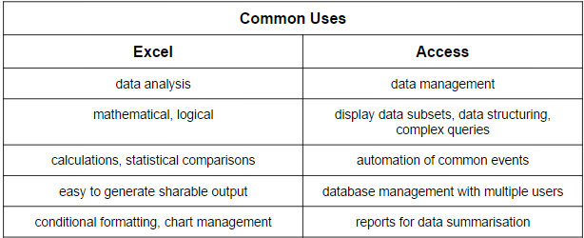
Choosing Between Access and Excel

Slide 53
What about Paper?
In general, a paper–based referral system should
  Collect client information to identify them and track progress made over time as part of the system
  Input new client info and referral history into a register
  Use referral forms when service provider is making a referral
  Use a separate form (or part of same form) to note when client arrives and service is delivered (or not)
  Include a referral card for clients to take with them after being referred
  Include a mechanism for the feedback loop to be closed in the register (referral completion %)

Slide 54
Review Examples
Intake Form (also known as Registration)
Referral Card
Referral Form

Slide 55
Questions to Ask
How do you want to organize your data?
  Repetitive? Duplication?
  Action tracking/event management?
Are you storing and managing, or storing and analyzing?
How much data do you have?
  Text?
  Numerical?
Do you require formatting for sharable output?
Do you or a lead have familiarity with Excel and/or Access
What about a computer?

Slide 56
Paper vs Mobile Referral Systems
Paper may make the most sense for you all, especially because LIFT cannot support, but don’t forget that paper also will require resource investments!
 | Paper Based | Mobile Based
Initial Costs | Database Development Printing (high) Training | Database Development Phones or Tables Printing (low) Training
Recurring Costs | Staff LOE Printing Management Data Entry | Staff LOE Printing Management Data Bundles

Slide 57
LIFT Case Studies

Slide 58
Brief Review of LIFT Site Worksheet
Let’s take a few minutes and go through the worksheet outlining some referral systems that LIFT has helped implement across our project countries
  Part of LIFT’s mandate is to contribute to the evidence-base around establishing clinic-community linkages via things like referral systems
  **Open system comparison Word Doc on Computer

Slide 59
Brief Review of LIFT Site Worksheet
You can see that there are a number of different options we’ve tried – many successes, but not without challenges!
It is possible that KRN members could choose one of these approaches, and, if so, LIFT would be happy to share some tool templates with you
  Let Zach know!
On the other hand, you may decide to try a hybrid approach, or combination of different things
  This is completely fine, so long as you agree, are committed to the system and actively participate for the benefit of your clients!

Slide 60
Namibia Example

Slide 61
Referral Resources
Namibia Example
LIFT developed a suite of resources designed to execute referrals using the Ministry of Health’s bi-directional referral platform
Resources were designed with significant community and MOH input
33 members in Katutura (2 HFs; 14 GRS depts./SPs;16 NGOs and 1 Private company)
22 members in Engela (6 HFs, 9 GRN depts./SPs; 6 NGOs ; 1 Private organization)

Slide 62
Value Addition in Namibia
*Ideally, the KRS should add value to the work you are already doing
Builds on Namibia MOH and other existing service delivery platforms
Systematic approach in service delivery
Use of tools to measure effectiveness, efficiency and impact
Strengthens coordination and collaboration across sectors

Slide 63
Namibia Referral Resource Kit Contents
* Keep in mind that depending on your KRN priorities and resource capacities, not all of these resources may be relevant *
Forms
  Referral form
  Registers
  Supplemental client intake form and health questions
Referral Database
  Access database to store and report client/referral data
  Simple and effective data entry and reporting templates
  Simple database manual for RCO/HF and LCO
Notes:
- A complete set of tools and processes needed for effective implementation of the clinic-community referral system
- Easy-to-use, standardized referral tools and processes based on MoHSS systems and platforms that can be used by clinical and community-based service providers

Slide 64
Referral Resource Kit Contents (2)
Referral Network Operations Manual
  Defines roles of organizations within the network
  Outlines the entire referral process
  Defines standard operating procedures (SOPs)
  We will look at an RNOM from Balaka later
  4. Economic & Food Security Diagnostic Tool
  Rapid household assessment to facilitate match to best services
  Open diagnostic tool worksheet and briefly explain
Notes:
A complete set of tools and processes needed for effective implementation of the clinic-community referral system

Slide 65
Referrals Resource Kit Contents (3)
5. Local Service Directories
  Easy-to-use guide of locally available services, with eligibility criteria
  You’ve been given a draft version that can be used by service providers in Karonga going forward
Notes:
A complete set of tools and processes needed for effective implementation of the clinic-community referral system

Slide 66
Referrals Resource Kit Contents (4)
6. Client Counselling Guidance Document
  Guides discussion with the client based on diagnostic scores, client preferences, and available services
  Remember the discussion earlier and our activity
  7. Simple Referral Cards
  Provided to clients to take with them after a referral is made, and give to service provider receiving their referral
  Can be used to help track referral completion and target follow-up, as needed
Notes:
A complete set of tools and processes needed for effective implementation of the clinic-community referral system

Slide 67
HF = Health Facility
RCO = Referral Coordinating Organization
SP = Service Provider
LCO = Lead Coordinating Organization
STEP I: Health Facility (HF)
Complete client intake
Assign client number
Collect and enter health data
Refer client to RCO
Give client referral form
STEP 2: RCO
- Receive clients from HF and SPs
- Assign client number (if not already assigned)
- Use diagnostic tool and counseling guidance
- Coordinate referral(s)
- Give client referral form
STEP 3: Service Provider (SP)
Provide services to client
Return referral feedback form to RCO
SP1
Health Facility
RCO
Client
SP2
STEP 4: RCO
- Enter referral feedback into database
- Notify HF of referral completion
Periodically: LCO
- Send merged data files back to HFs and RCOs to load into database
- Generate network reports
LCO
Periodically: HF & RCO
HFs and RCOs regularly send database files to LCO to be merged and synced
= Client Flow
= Paper Referral Forms
= Database Sharing

Slide 68
Lilongwe and Kasungu

Slide 69
Bi-directional VSLA to NCST
Number and type of network members
  17 NCST facilities (10 in Lilongwe; 7 in Kasungu)
  2,000 existing VSLAs
Key coordinating orgs/actors
  NCST Personnel identified in conjunction with HSAs, Expert Clients, Mother Mentors, Referral Volunteers and Village Agents
  Health Personnel in Public Health, HTC and ART are acting as focal persons.

Slide 70
Malawi – Acceleration Overview
Main tools in use
  Referral cards
  Client registration books
  Client IDs used in different forms
    In some HCs, ART or HCC IDs used as harmonizing means
    In other HCs, IDs generated with support of LIFT project are used for confidentiality
  Reporting forms
  Excel database

Slide 71











Malawi Acceleration Referral Process
Methodological Adjustments
Constitutional review, social fund expansion; flexible saving regime
Community Mobilization| Mobile HTC services(Macro) |
CBO campaigns | CARE Groups/SG referrals
Village Agent
VSLA
Referral Volunteer
Client
Registration; Counseling; Referral cards; Referral to VSLA, Support Group
Also done by Mother mentor, HSA, Expert Client
Peer Support Groups
HSA
Health Staff, Mother mentor, HSA, Expert Client
Food Assistance
Prioritize HTC, Pre/ART, NACS Clients
Gov./NGO program

Slide 72
Malawi – Key Successes
Existing VSLAs and NCST facilities as entry points
Link to existing SGs, paper-based card system is simple to use
2,194 clients reached as of Jan 2015
Service access is 85%+ in Lilongwe, 90%+ in Kasungu
ES and short-term food support/RUTF, links to SGs and care groups (nutrition)
TA, CB activities, referral tools, logistical support all help motivate implementation
Referral completion – use cards to track path
NCST focal persons complete a short report form that captures referral activities and services accessed
Potential to scale
Notes:
Time and cost to set up: The system uses VSLAs and NCST facilities as entry points. There are plenty of existing Savings Groups/VSLAs in the districts, and the existing databases for such groups makes the mapping exercise easier and cheaper. Since it is community based, the next step which includes community sensitizations, negotiation with specific groups and also coordinating, collaborating and orienting with NCST facilities , takes about a month or two. And by three months referrals should start rolling. The cost that might be met is the logistical, stationery and orientation workshop and a pushbike for Referral volunteers which so far has been relatively low.
Harmonization with existing systems: Currently the system that has been set up is based on existing structures: established SGs and NCST facility personnel. LIFT works with facilities to issue the client ID on referral cards ( this could be linked to ART and HCC numbers). Initially LIFT introduced a parallel ID system, which proved laborious and difficult to link it to the NCST paper based recording system. Once a client is referred to a service a card serves as a tracking mechanism as eventually the card is expected to be traced back to the NCST facility for referral access verification.
Functionality and ease of use: The existence of ES such as SGs and the paper based card system simplifies the system. The linking of records to NAST facilities makes it easy to track clients who have accessed services. Clients easily understand the referral system.
Client reach: As of January 2194 clients received referrals in Lilongwe and Kasungu. LIFT expects to hit the 3000 clients by February 2015. The utilization/access of services is above 85% in Lilongwe and above 90% in Kasungu.
Number/range of services offered and ability to meet longer-term ES/L/FS needs: Current service offered is economic strengthening service and short term food support/RUTF (in limited NCST sites due to stockouts), links to Support Groups and Care Groups(nutrition)
Motivation of network to implement: Technical Assistance, Trainings/capacity Building activities, Referral Tools and materials (cards, documentation books etc.), logistical support for follow up such as pushbikes
Referral follow up/feedback/completion: Cards completing a circle i.e. from a point of referral, IDs help track a client whether they have accessed a referred service or not through the help of a cadre of volunteers in the community involved in the project. Final destinations of the cards are the NCST facilities, who tally issued cards and received clients to establish utilisation.
Ability to collect and report on data of interest (DT, HIV, adherence, etc): Each NCST facility has a focal person.-either ART, HTC or Expert Client who , complete a short report form that captures referral activities, number of PLHIV in catchment area, Clients who accessed HTC,ART, Nutrition services. (Analysis on adherence has not been done yet ,but anecdotal feeback from NCST staff indicate that the referral system is helping. The adoption of NCST ID numbers on Client ID is expected to “ease” the analysis.
Ability to replicate with lower LIFT investments: strong base of the SGs, existing cadre of staff in NCST facilities and volunteers in communities who already work with the clients, low cost nature of the model makes it scalable..

Slide 73
Malawi – Key Challenges
Maintaining confidentiality throughout referral process
Limited NCST staff, competing times between clinical services and referrals
Notes:
Maintaining Confidentiality through out the referral process| As the traffic of clients receiving referrals to VSLAs increased, the more challenging it became to maintain confidentiality around the HIV status of the clients, especially that some of them voluntarily disclosed their status and highlighted that they have been referred from support groups or NCST facility.
Limited NCST staff, competing times between clinical services and referrals to VSLAs was another issue that kept cropping up during the facility visits. Focal persons in the health centers have expressed concern on potential work overload. However, the coming in of 25 RV has tremendously eased their “burden”. This is also supported by agreeing to schedule our times for monitoring, reporting to coincide with their schedules. Manual data collection and documentation poses a challenge for linking referral information to NCST databases. However , the use of a singular Client ID, generated by the facility makes client follow up easy, and simplifies traceability of the referral.

Slide 74
ODK and Paper in Tanzania

Slide 75
Tanzania – Overview
22 organizations in the network
Coordinating Org: Allamano Health Center
Tools:
  Enrollment form (paper & ODK)
  Organization cards – laminated sheet of card stock with orgs & directions
  Referral card (paper)
  Referral slip (entered into ODK)
  Directions for referral ID numbers
  Directions for referral processes

Slide 76
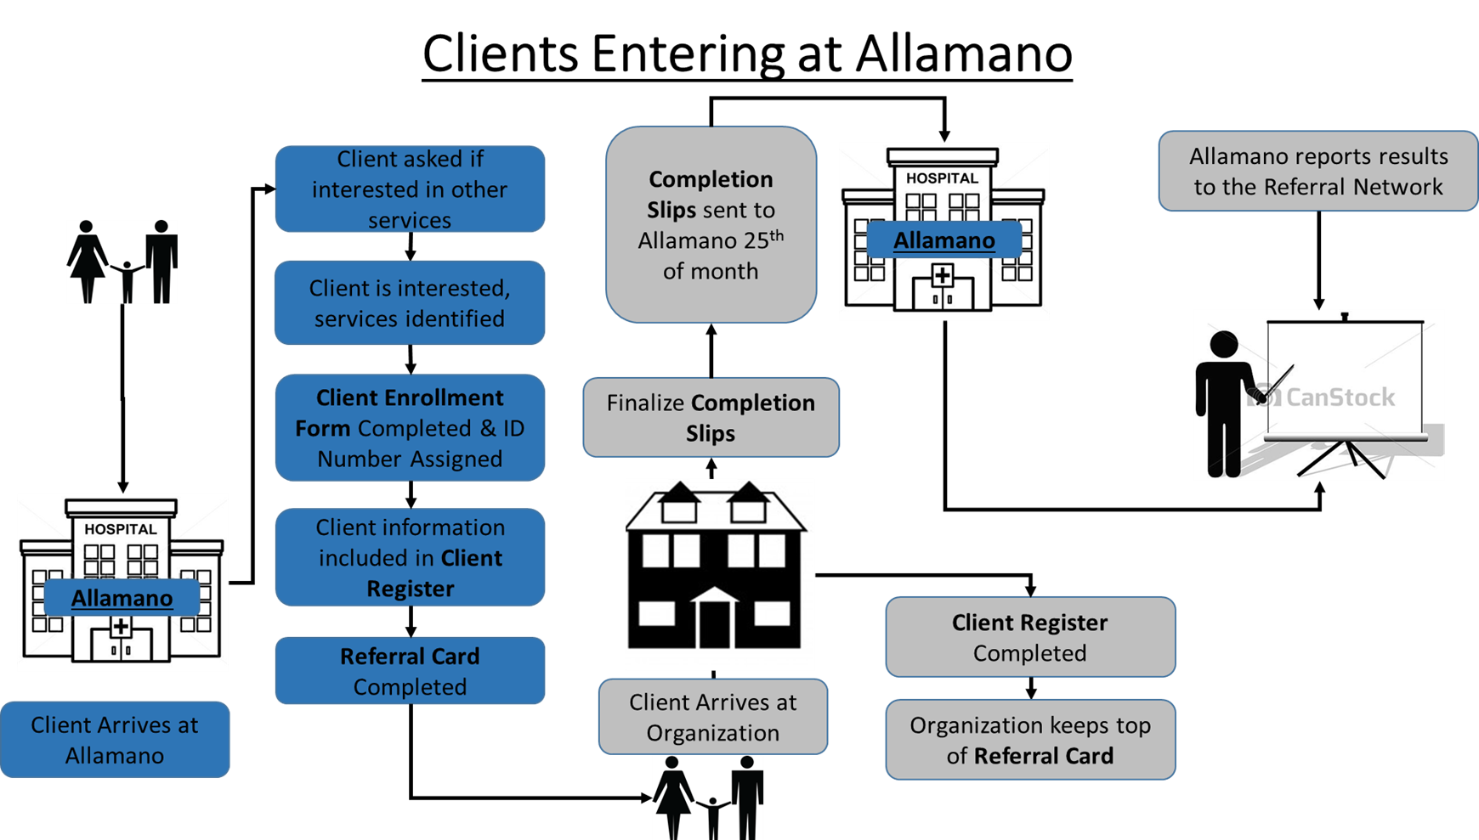
Tanzania – Referral Process

Slide 77
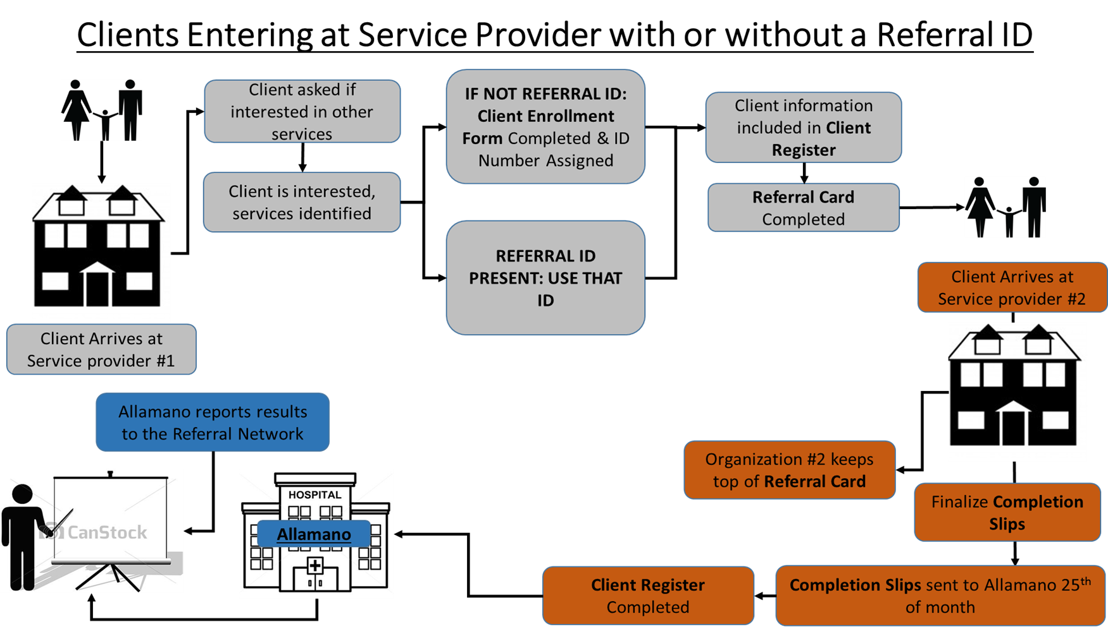
Tanzania – Referral Process (cont.)

Slide 78
Tanzania – Key Sucesses
~1 year – intensive activity July - October
Allamano was previously referring clients to internal savings and other activities that were within their organization
Process is relatively functional for organizations, they have asked for funds or other support to implement
~300 clients from Oct - Dec
22 organizations, at least 6 categories of services offered (approximately 50 offerings)
  1) Agr/home garden, 2) Health, 3) ES, 4) Youth & orphans, 5) GBV/VAC, 6) Food support

Slide 79
Tanzania – Key Successes (cont.)
Motivation: See linkages as beneficial for future funding, capacity development opportunities
Referral completion and follow up is happening
Referral client records linked to health records at the clinic

Slide 80
Paper-Based in Zambia

Slide 81
Zambia – Overview
District wide network with many members currently engaged (33 ES/L/FS service providers, 3 private sector contributors, currently 5 HFs but up to 34 HFs )
Hoping to utilize NHCs and social workers or others based at the HFs for support in making/coordinating referrals
Exploring having Kitwe District Medical Office allocate a staff member (M&E) to support overall network coordination and data management

Slide 82
Zambia
Tools:
  Paper referral forms, paper registers, paper monthly reporting templates, health questions, possibly DT. Excel file for data compilation at networks level. May integrate more technology later
Open referral process where any SP/HF can refer to another directly (1-step process)
Still determining who can/will ask health questions
  Remember that LIFT is funded by PEPFAR (health q’s may not be priority/relevant for KRN)
  What is of interest to KRN? It is up to you to develop tools that collect this client information

Slide 83
Referral Process: HF Entry Point
STEP 1:
Complete client intake
Assign Client ID Number (use SmartCare Number where relevant)
Collect and record health data
Use referral directory and counseling guidance
Give client referral form
Refer client to SP(s)
Record referrals in register
HF = Health Facility
RCO = Referral Coordinating Organization
SP = Service Provider
LCO = Lead Coordinating Organization
STEP 2a:
Provide services to client
Return referral feedback form to HF
Complete referral register
SP2
Health Facility*
SP4
STEP 3:
- Enter referral feedback into register
- Complete any client follow up indicated
STEP 2b:
Follow up with SPs/client if referral feedback is not received within 2 weeks
LCO
*HF staff will utilize Social Workers or NHC volunteers onsite to make and record referrals, and enter completed referrals into the register.
= Client Flow
= Referral Forms

Slide 84
Referral Process: SP Entry Point
STEP 1:
Complete client intake
Assign Client ID Number (use SmartCare Number where relevant)
Collect and record health data
Use referral directory and counseling guidance
Give client referral form
Refer client to SP(s)
Record referrals in register
HF = Health Facility
RCO = Referral Coordinating Organization
SP = Service Provider
LCO = Lead Coordinating Organization
STEP 2a:
Both HF and SP4 will:
Return referral feedback form to SP
Provide services to client
Complete referral register
HF
STEP 2b:
HF will also:
Link client to SmartCare record (where relevant)
Collect and record health data
SP1
SP4
STEP 3:
- Enter referral feedback into register
- Complete any client follow up indicated
LCO
STEP 2c:
SP1 follows up with HF/SP4/client if referral feedback is not received within 2 weeks
= Client Flow
= Referral Forms

Slide 85
Referral Data Aggregation Process
HF = Health Facility
RCO = Referral Coordinating Organization
SP = Service Provider
LCO = Lead Coordinating Organization
Monthly:
SP1
SP2
Health Facility
SP3
SP4
HFs and SPs send monthly reporting forms to LCO
SP5
LCO conducts data aggregation and analysis and sends reports to all network members
LCO
= Monthly Reporting Forms

Slide 86
Zambia – Key Successes
Moving fairly quickly (~5 months from mapping to launch)
Working with the Kitwe Medical Office to harmonize tools and processes with existing structures
Familiarity with paper may make it relatively easy to use by members; no technology so no duplication of paper and electronic data recording
Large number and wide range of services included
Great participation and motivation from steering committee
System will be set up to collect and report on data of interest (HIV, adherence, DT, etc.)

Slide 87
Zambia – Key Challenges
Data reporting will be more burdensome since not automated
System will not be able to merge individual client records from different sites
System will not report longitudinal data on clients
Still determining who will be able to ask and record HIV/adherence data – may be a small subset of network members
Referral follow-up process is still being defined
Referral feedback process is still being defined but will utilize paper slips

Slide 88
Referral Tools in Greater Detail

Slide 89
Client Intake Form
Also can be considered a client registration form
Used to collect basic information from new clients hoping to be connected to other services via referral
To protect client identity, a unique client ID should be assigned each individual
  Remember that as service providers, clients are trusting you to help them and keep things like their health status confidential
  **Open Example Form

Slide 90
Referral Card
Given to clients by RN member service providers when they are making a referral
At the minimum, card should note
  Client ID #
  Date
  Where client is being referred from
  Where client is being referred to
Clients should present card when arriving to receive referred service, and receiving service provider should collect and give to lead entity on a regular basis
  Up to KRN to decide how “regular”
  Will inform referral completion % of RN membership, and help determine cases for follow-up
  **Open Example Card

Slide 91
Referral Register
Documents clients that have been brought in and registered as part of the referral system
Individual RN members keep a register to account for their own activity as part of the network
Track referrals made and completed by each client over time
  Importance of client ID
Lead/Coordinating entity should likely keep a “master” register (aka, database)

Slide 92
Referral Operations Manual
Explains referral system in detail
Outlines agreement between members
Provides an overview of the referral process a client goes through
Explains different forms/tools being used as part of the system
Explains roles and responsibilities of RN members
Provides some tips in case of challenges confronted
Lists contact information of key members (Leads)
**Open RNOM from Balaka

Slide 93
Referral Tool Review
Take some time to think about the different systems we’ve outlined
Remember the tools that were used to facilitate referrals in each case
Do you feel similar tools could be easily developed by you all in Karonga?

Slide 94
Referral Process Activity
Gather in groups of 2-4 people
Using the provided poster paper and markers, sketch out a referral process that you think could work well in Karonga
Think about where clients enter the referral system and how they will interact with you all (service providers)
Please write down what tools you think should be used at each stage to help get the client referrals for services they need
Be prepared to present your ideas!

Slide 95
Action Planning and Questions to Consider

Slide 96
Questions for YOU to Consider
What value do you see in creating a referral network here in Karonga?
What information would you or your organization like to learn from it?

Slide 97
Questions
Given the examples and discussion, what do you think is realistic for Karonga?
What kind of referral system/approach?
  Bi-directional, uni-directional, clients entering at HF, or during referral corner, other?
What resources, if any, will you need to procure to make your vision a reality?

Slide 98
Questions
What referral tools already exist in Karonga that could be capitalized upon?
When and how often can you gather together to continue this work, even in LIFT’s absence?

Slide 99
Questions
How large should the network be?
Are there any organizations that LIFT has not engaged who you feel should be invited into this process?
  If so, LIFT recommends a similar service directory entry be created for them
Who could be responsible for “leading” or coordinating members, at least initially?

Slide 100
Road Map for KRN
What are the next steps to take this work forward?
Who can commit to participating?

Slide 101
Building a Referral Network (RN)
LIFT’s Recommendations to KRN
  Identify organizations you want to invite to be members
  Bring stakeholders together to discuss RN
  Choose a lead/coordinating organization or entity
  Draft an MOU/agreement between members of the RN
    Commitment is key!
  Collectively finalize referral tools
  Train staff at your organizations/offices
  Sensitize the community/raise awareness about the Karonga Referral System

Slide 102
Recommendations
  After core group committed to idea is formed, come together to decide on RS structure and tools needed
  Initially, I would focus on simplicity, and take advantage of opportunities to gather together to inform one another of program changes
    Can always add features and tools later, once become accustomed with processes
  Even if the RN remains “informal” by sharing program info and gathering regularly to discuss district priorities, you will be better prepared to serve your clients and help address all of their needs together

Slide 103
Just FYI
If you want to know more about referral system development or read about different tools we have used, there is a lot of information available on our website:
  http://theliftproject.org/
Also, even though LIFT is no longer working in Karonga, we want to see you succeed. You can email me with questions or comments, and I will help as much as possible:
  zandersson@fhi360.org

Slide 104

Zikomo kwambire!!

